Slide 1

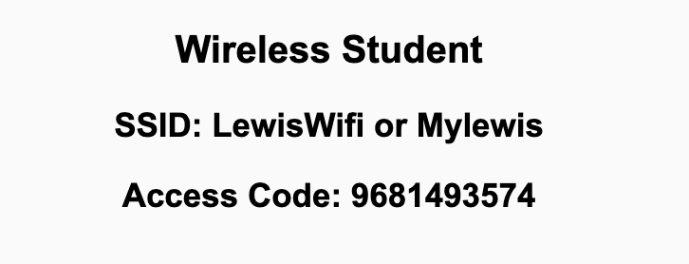
Preflight Check List
Sign into our Zoom meeting through our integrated Blackboard/Zoom link
Make sure that you can hear the conversation, see shared desktops, and view chat topics
Thank you if you choose to leave your camera on to help make our class more interactive
Be prepared to share your computer screen
Be prepared to utilize a headset with a microphone
In person participants also:
Make sure that your microphone and speakers are muted/off so that we don’t get an echo
Sit in a good spot near the classroom ceiling microphones if possible

Slide 2
Recordings
Discuss that recording are:
Opportunistic
Automatically available in Blackboard/Zoom
Sound Check… plus Video, and Desktop Sharing… check
Load Polls… check
Start Recording

Slide 3
Introduction to Computer Science
Eric Pogue

Slide 4
Agenda:
Friendly Conversation Topic
Prework and Announcements
Introductions – Part 1
Sprint 1 Planning (abbreviated)
Assignment
Introductions – Part 2 including Scrum Team Assignments
Discussion & Questions welcome at any time but please be present with no phones or email during our time together

Slide 5
Friendly Conversation Topic
What is a Friendly Conversation Topic?
It’s a topic that is not directly related to course topics but a topic that is relevant, current, and hopefully interesting.

Slide 6
Friendly Conversation Topic – Team Communication Tools
What is your preferred small team communication tool?
Do you have a Discord account?
What has been your experience with Discord?

Slide 7
Prework & Announcements
Welcome Message
Blended Learning
Scrum

Slide 8
Polling

Slide 9
Class Format
Synchronous vs Asynchronous
Local (In Person) vs Remote
We are synchronous.
We will be in person Mondays and Wednesdays and remote on Friday.
My expectation is that you will be here in person Mondays and Wednesdays. If you need to be remote Monday or Wednesday, we understand but please be appreciative of your scrum teammates.
Priorities:
Health and safety
Effective teaming and association
Intended course schedule

Slide 10
Introductions

Slide 11
Foreshadowing Your Introductions
Be prepared to share your:
Preferred name and seat number
Major / Minor
Programming Experience (1 to 5)
An interesting fun fact about yourself
Favorite “adjective/noun” scrum team name

Slide 12
Scrum Team Names
Scrum team names from previous semesters:
EZScrumEZGo
SourPatchEngineers
DreamRaccoons
TeamFun
SwagMoney
MonaLisas
Scrumdiddlyumptious
FightingBass
TitanicSwimTeam
GloriousKenobis
RedDragons
ScrumciousCoders
Mongooses
Scrumples
WubbaLubbaDubDubs
RedPandas
SpiderScrum
MadSanitizers
SpeedCoders
StingyTadpoles
BlueThrees
PurpleCobras
ScruptyDupty
LaughableCaterpillars
PurplePirates
ScrumIsFum
ScrummyScrumbags
TheCrew
WickedCrew
SpicyChalupa
ScrumOfTheEarth
LightningMcQueen
Notes:
Hand out name tags and introduction forms before Syllabus Overview

Slide 13
Introductions – Part 1

Slide 14
Introductions
Full and Preferred Name:
Eric Pogue
Eric, Mr. Pogue, or Professor
Family, Home, College background:
Married with five children, relocated from Davenport, IA to Chicago area
Undergraduate in CS and Masters in Business… teaching evenings for many years
Programming experience:
Decades in the industry as a developer, architect, project manager, division manager, and vice president of various software development organizations
Part of many teams that have delivered products to ten’s of millions of customers globally
Parsons Technology, Intuit, The Learning Company, Jasc Software, and John Deere
… and most recently working on a startup product “Stadia” with my oldest son
Second year teaching full-time

Slide 15








Slide 16
Introductions
Likely programming environment
MacOS, Terminal, Visual Studio Code, and Chrome/Firefox web browser
Top two or three things that you would like to get out of this class
To learn something myself while helping each of you be successful
Motivate you to look deeper while we are exploring technologies and processes
Help you build something that makes you proud
Hobbies:
Wilderness Canoeing & Camping (Quetico) and Triathlons
Fun Fact:
At one point I had the very dubious “honor” or being the most traveled John Deere employee to India with 40+ trips over a 5-6 year period while setting up the 400+ person John Deere Technology Center – India Software Development organization.
Notes:
Vanity

Slide 17

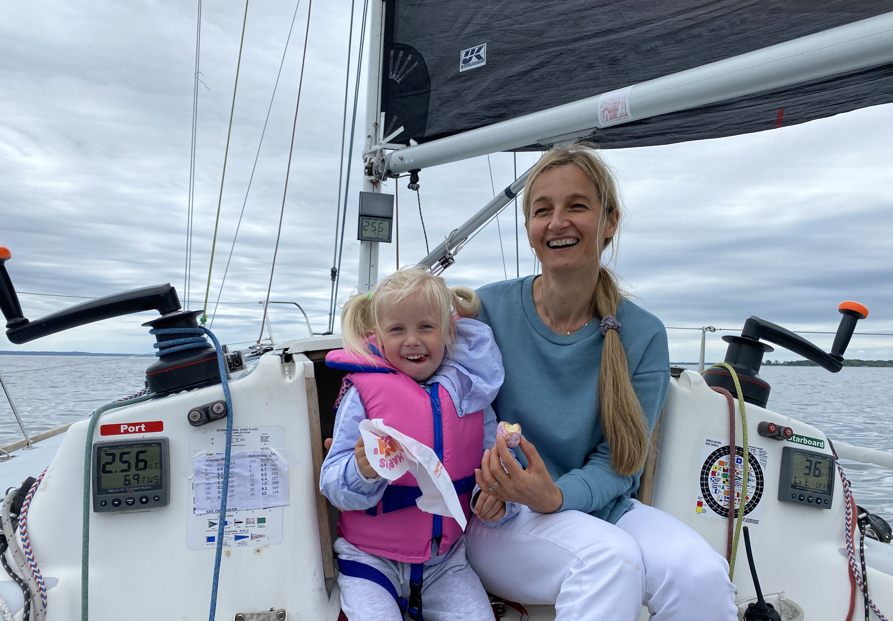
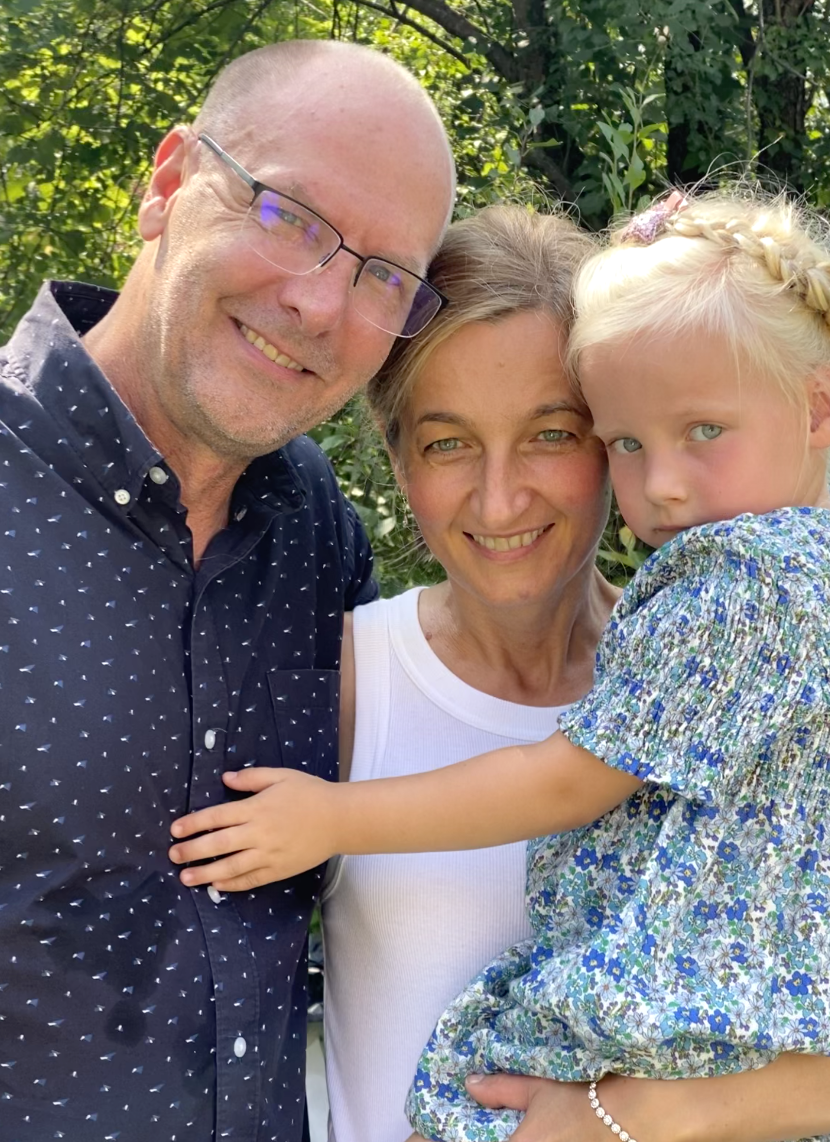
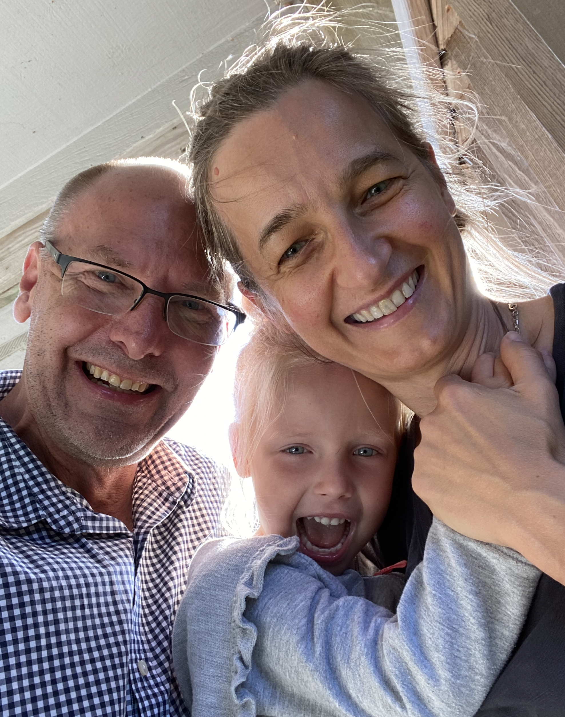
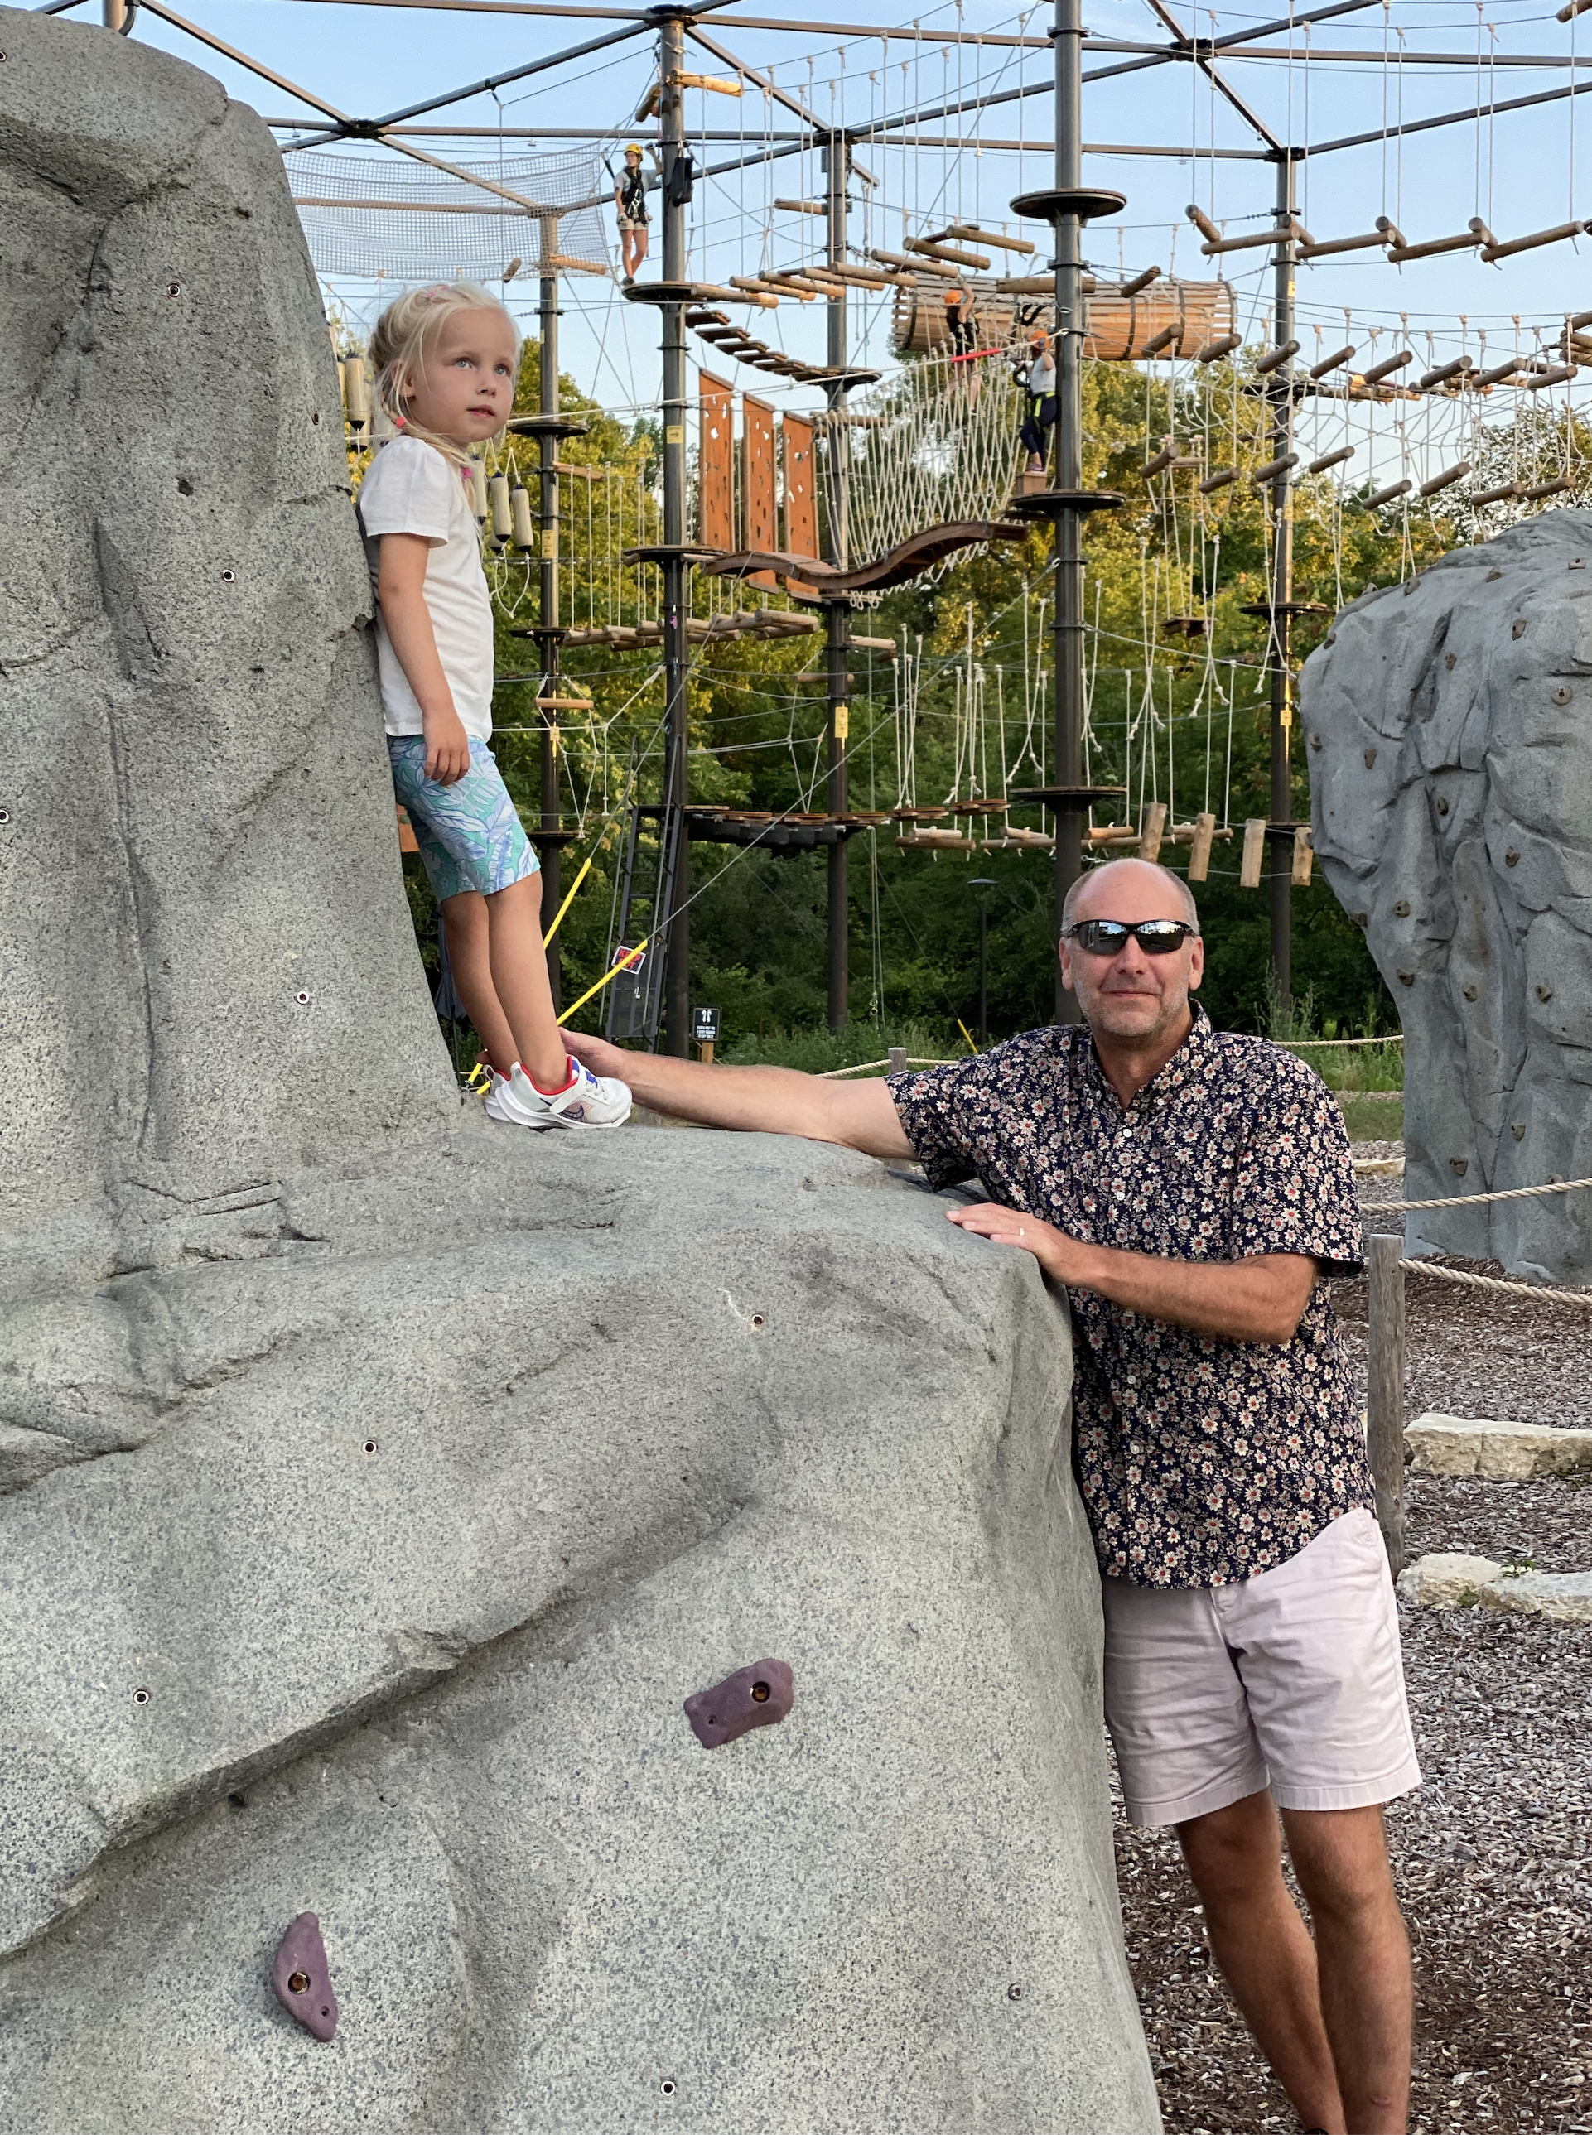


Slide 18
Sprint 1 Planning (abbreviated)

Slide 19
Sprint Planning
We will be doing sprint planning at the beginning of each of our 8 sprints during the semester.
What’s different about Sprint 1 planning?
We will need to finish Sprint 1 planning on Wednesday because we want to make sure that we have time for Introductions and initial Scrum Team assignments today
Next Monday is a Holiday so we will be missing one class session this sprint

Slide 20

Scrum Process – Sprint Planning
By Dr ian mitchell - Own work, CC BY-SA 4.0, Link

Slide 21
Review Announcement, Activities List,
Assignments, and Syllabus

Slide 22
Sprint Planning
(to be continued Wednesday)

Slide 23
Prework For Next Class
Complete through activity 6 prior to next class
Be ready to test your scrum team discussion capabilities with your team Discord server*
Get your headset (that includes a microphone) for teaming and programming together activities

Slide 24



Headset Options
What would I recommend?
Airpods or Comparable Sennheiser
Maybe Gaming
Headphones?

Slide 25
Introductions – Part 2

Slide 26
Polling of In Person Preferences and
Programming Experience

Slide 27
Scrum Team Names
Scrum team names from previous semesters:
EZScrumEZGo
SourPatchEngineers
DreamRaccoons
TeamFun
SwagMoney
MonaLisas
Scrumdiddlyumptious
FightingBass
TitanicSwimTeam
GloriousKenobis
RedDragons
ScrumciousCoders
Mongooses
Scrumples
WubbaLubbaDubDubs
RedPandas
SpiderScrum
MadSanitizers
SpeedCoders
StingyTadpoles
BlueThrees
PurpleCobras
ScruptyDupty
LaughableCaterpillars
PurplePirates
ScrumIsFum
ScrummyScrumbags
TheCrew
WickedCrew
SpicyChalupa
ScrumOfTheEarth
LightningMcQueen
Notes:
Hand out name tags and introduction forms before Syllabus Overview

Slide 28
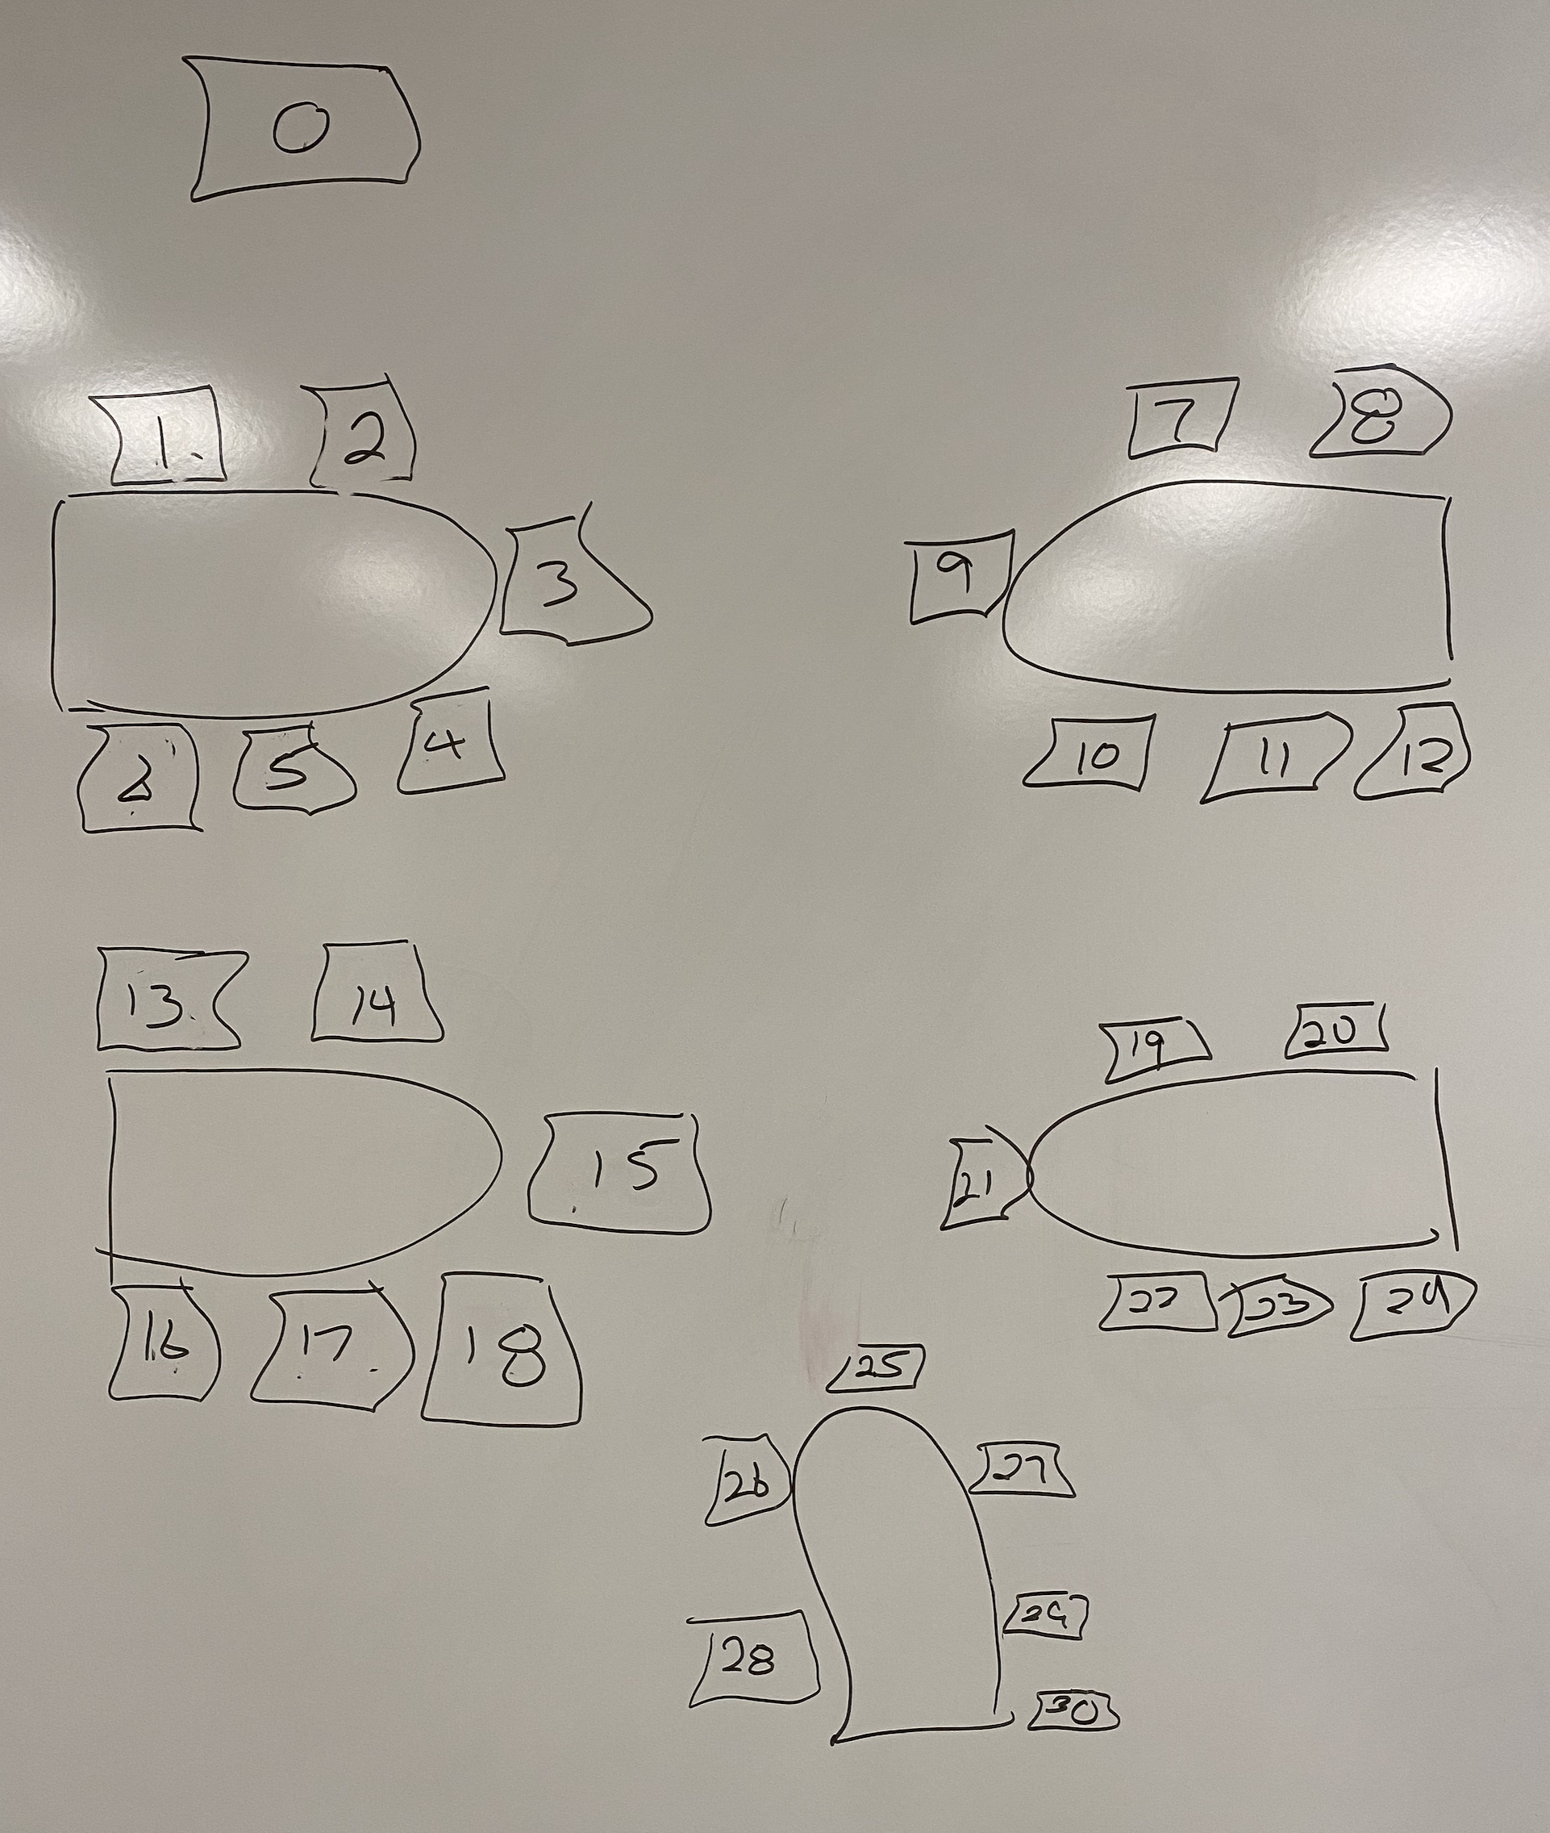
Foreshadowing Your Introductions
Be prepared to share your:
Preferred name and seat number
Major / Minor
Programming Experience (1 to 5)
An interesting fun fact about yourself
Favorite “adjective/noun” scrum team name

Slide 29
End of Session

